Slide 1
Creating Synthetic Microdata for
Higher Educational Use in Japan:
Reproduction of Distribution Type based on the Descriptive Statistics
Kiyomi Shirakawa
Hitotsubashi University / National Statistics Center
Yutaka Abe
Hitotsubashi University
Shinsuke Ito
Chuo University

Slide 2
Outline
1. Synthetic Microdata in Japan
2. Problems with Existing Synthetic Microdata
3. Correcting Existing Synthetic Microdata
4. Creating New Synthetic Microdata
5. Sensitivity Rules for New Synthetic Microdata
6. Comparison between Various Sets of
Synthetic Microdata
7. Conclusions and Future Outlook

Slide 3
1. Synthetic Microdata in Japan
Synthetic Microdata for educational use are available in Japan:
  Generated using multidimensional statistical tables.
  Based on the methodology of microaggregation
(Ito (2008), Ito and Takano (2011), Makita et al (2013))
Created based on the original microdata from the 2004 ‘National Survey of Family Income and Expenditure’
Synthetic microdata are not original microdata.

Slide 4
Legal Framework
New Statistics Act in Japan(April 2009)
Enables the provision of Anonymized microdata (Article 36) and tailor-made tabulations (Article 34).
  Allows a wider use of official microdata.
  Allows use of official statistics in higher education and academic research.
  However, permission process is required.
To provide an alternative to Anonymized microdata, the NSTAC has developed Synthetic microdata that can be accessed without a permission process.

Slide 5
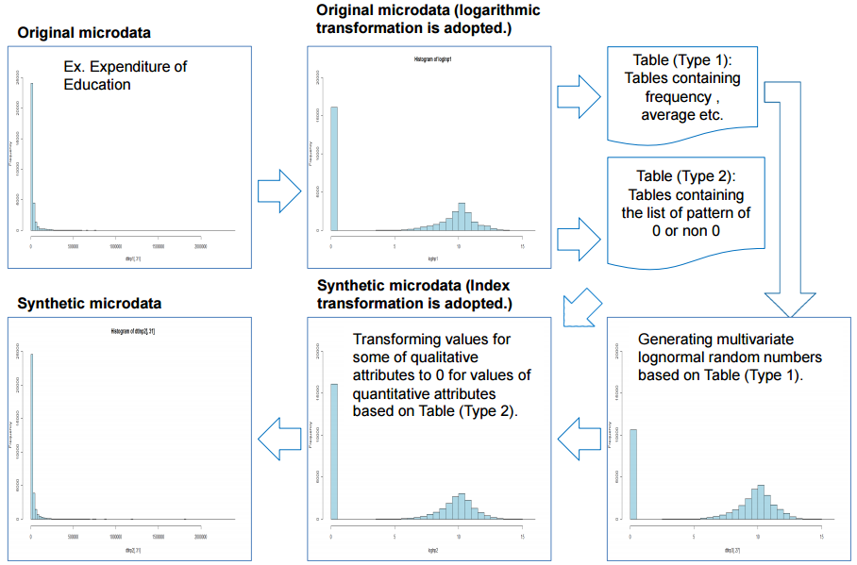
Image of Frequency of Original and Synthetic Microdata
Source:
Makita et al. (2013).

Slide 6
2. Problems with Existing Synthetic Microdata
(1) All variables are subjected to exponential transformation in units of cells in the result table.
Number of Earners | Structure of Dwelling | Frequency | Living Expenditure |  |  | Food
 |  |  | Mean | SD | C.V. | Mean | SD | C.V.
One person |  | 4,132 | 302,492.8 | 148,598.9 | 0.491 | 71,009.0 | 25,089.5 | 0.353
 | Wooden | 1,436 | 300,390.3 | 170,211.4 | 0.567 | 71,018.5 | 24,187.6 | 0.341
 | Wooden with fore roof | 501 | 298,961.0 | 125,682.9 | 0.420 | 73,507.3 | 24,947.7 | 0.339
 | Ferro-concrete | 1,624 | 306,947.4 | 131,895.0 | 0.430 | 69,873.1 | 25,844.2 | 0.370
 | Unknown | 571 | 298,209.7 | 153,651.1 | 0.515 | 72,024.1 | 25,125.1 | 0.349
Two persons |  | 4,201 | 346,195.7 | 215,911.7 | 0.624 | 78,209.1 | 25,288.1 | 0.323
 | Wooden | 1,962 | 346,980.3 | 172,673.2 | 0.498 | 78,961.7 | 24,233.5 | 0.307
 | Wooden with fore roof | 558 | 356,021.5 | 160,579.8 | 0.451 | 81,039.4 | 24,628.2 | 0.304
 | Ferro-concrete | 1,120 | 353,093.9 | 313,837.8 | 0.889 | 76,860.8 | 26,250.7 | 0.342
 | Others | 3 | 260,759.8 | 37,924.3 | 0.145 | 72,733.1 | 5,358.9 | 0.074
 | Unknown | 558 | 320,224.5 | 148,230.3 | 0.463 | 75,468.5 | 27,241.1 | 0.361
Too large

Slide 7
(2) Correlation coefficients (numerical) between all variables are reproduced.
In the below table, several correlation coefficients are too small.
The reason is that correlation coefficients between uncorrelated variables are also reproduced.
 | Living expenditure | Food | Housing
Living expenditure | 1.00 | 0.50 | 0.28
Food | 0.43 | 1.00 | -0.03
Housing | 0.28 | -0.06 | 1.00
Too small
Top half: original data; bottom half: synthetic microdata

Slide 8
(3) Qualitative attributes of groups having a frequency (size) of 1 or 2 are transformed to "Unknown" (V) or deleted.
The information loss when using this method is too large.
Furthermore, the variations within the groups are too large to merge qualitative attributes between different groups.
Note: "V" stands for "unknown".
Source: Makita et al. (2013).
Figure 1: Processing records with common values for qualitative attributes into groups with a minimum size of 3.

Slide 9
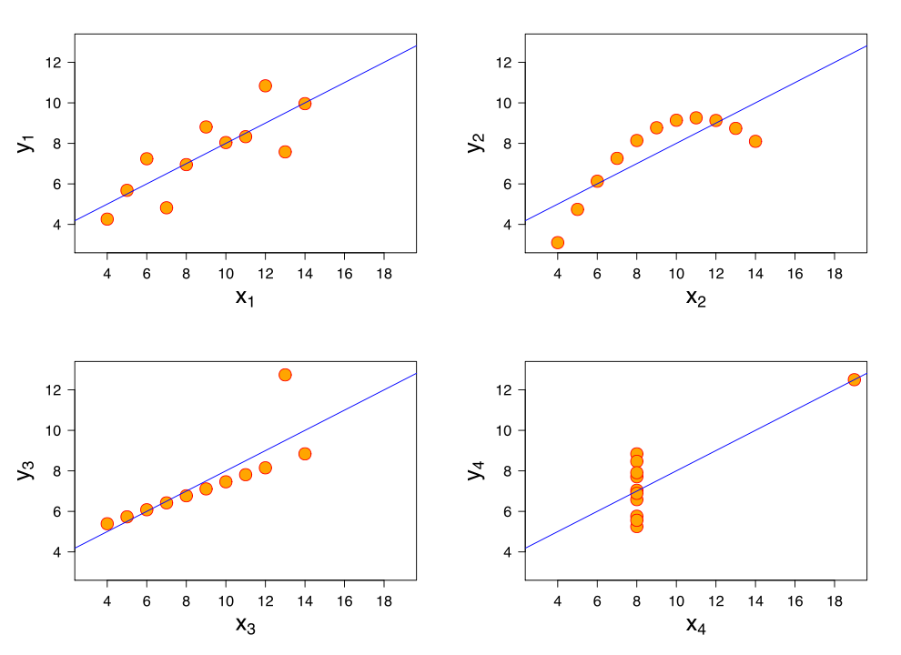
Scatter plots of numerical examples for Anscombe's quartet

Slide 10
Examples of numerical values for Anscombe's quartet
I |  | II |  | III |  | IV
x | y | x | y | x | y | x | y
10.0 | 8.04 | 10.0 | 9.14 | 10.0 | 7.46 | 8.0 | 6.58
8.0 | 6.95 | 8.0 | 8.14 | 8.0 | 6.77 | 8.0 | 5.76
13.0 | 7.58 | 13.0 | 8.74 | 13.0 | 12.74 | 8.0 | 7.71
9.0 | 8.81 | 9.0 | 8.77 | 9.0 | 7.11 | 8.0 | 8.84
11.0 | 8.33 | 11.0 | 9.26 | 11.0 | 7.81 | 8.0 | 8.47
14.0 | 9.96 | 14.0 | 8.10 | 14.0 | 8.84 | 8.0 | 7.04
6.0 | 7.24 | 6.0 | 6.13 | 6.0 | 6.08 | 8.0 | 5.25
4.0 | 4.26 | 4.0 | 3.10 | 4.0 | 5.39 | 19.0 | 12.50
12.0 | 10.84 | 12.0 | 9.13 | 12.0 | 8.15 | 8.0 | 5.56
7.0 | 4.82 | 7.0 | 7.26 | 7.0 | 6.42 | 8.0 | 7.91
5.0 | 5.68 | 5.0 | 4.74 | 5.0 | 5.73 | 8.0 | 6.89
Property | Value
Mean of x in each case | 9 (exact)
Sample variance of x in each case | 11 (exact)
Mean of y in each case | 7.50 (to 2 decimal places)
Sample variance of y in each case | 4.122 or 4.127 (to 3 decimal places)
Correlation between x and y in each case | 0.816 (to 3 decimal places)
Linear regression line in each case | y = 3.00 + 0.500x (to 2 and 3 decimal places, respectively)
http://en.wikipedia.org/wiki/Anscombe%27s_quartet

Slide 11
A Kind of Synthetic microdata in Japan
●Statistical Tables
No tabulation: maximum, minimum, median, range
Individual microdata
AUF
(Academic Use Files)
PUF
(Public Use Files)
frequency, mean,
standard deviation
frequency, mean, SD
correlation coefficient,
skewness, kurtosis
not consider original dist. type
reproduce original dist. type

Slide 12
Information
Shortly, the National Statistics center will be delivering new Public Use File in the National Survey of Family Income and Expenditure 2009.
However, there isn't a plan that creating an 'Academic Use File'.
Therefore, in this paper, we will be suggestion of a creating its file.

Slide 13
3. Correcting Existing Synthetic Microdata
The following approaches can be used to correct the existing Synthetic microdata.
Select the transformation method (logarithmic transformation, exponential transformation, square-root transformation, reciprocal transformation) based on the original distribution type (normal, bimodal, uniform, etc.).
Detect non-correlations for each variable.
Merge qualitative attributes in groups with a size of 1 or 2 into a group that has a minimum size of 3 in the upper hierarchical level.

Slide 14
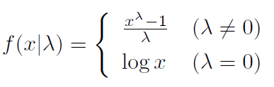
Box-Cox Transformation
λ = 0 logarithmic transformation
λ = 0.5 square-root transformation
λ = -1 reciprocal transformation
λ = 1 linear transformation

Slide 15
4. Creating New Synthetic Microdata
In order to improve problems with existing Synthetic microdata, new synthetic microdata were created based on the following approaches.
(1) Create microdata based on kurtosis and skewness
(2) Create microdata based on the two tabulation tables of the basic table and details table
(3) Create microdata based on multivariate normal random numbers and exponential transformation
This process allows creating synthetic microdata with characteristics similar to those of the original microdata.
It is called ‘Academic Use File' .

Slide 16
(1) Microdata created based on Kurtosis and Skewness
Differences of kurtosis and skewness
Original microdata and transformed indicators for each transformation
 | Original data | Log2 transformation | Natural lognormal transformation | Square-root transformation | Reciprocal transformation
Mean | 861.370 | 9.139 | 6.335 | 26.451 | 2.651
Standard deviation | 882.057 | 1.363 | 0.945 | 12.960 | 2.548
Kurtosis | 4.004 | -0.448 | -0.448 | 0.974 | 4.185
Skewness | 2.002 | 0.107 | 0.107 | 1.115 | 1.943
Frequency | 27
λ | -0.047（λ = 0 ）

Slide 17
(2) Microdata created based on two Tabulation Tables (Basic Table and Details Table)
Basic Table (matches with original mean and standard deviation, approximate correlation coefficients for each variable)
 | Living expenditure | Food | Housing
Mean | 195,624.8 | 54,647.8 | 1,648.8
Standard deviation | 59,892.6 | 21,218.1 | 3,144.4
Kurtosis | -1.004164 | 1.628974 | 6.918601
Skewness | 0.346305 | 0.992579 | 2.605260
Frequency | 20 | 20 | 8
Correlation coefficients | Living expenditure | Food | Housing
Living expenditure | 1
Food | 0.643 | 1
Housing | -0.335 | -0.489 | 1
Details Table (means and standard deviations for creating synthetic microdata for multidimensional cross fields)
Groups | Living expenditure |  |  | Food
 | Frequency | Mean | Standard deviation | Frequency | Mean | Standard deviation
1 | 3 | 185,499.9 | 65,680.5 | 3 | 31,193.5 | 6,406.9
2 | 3 | 150,424.8 | 28,599.3 | 3 | 51,457.2 | 20,795.2
3 | 3 | 269,749.0 | 43,611.7 | 3 | 80,520.1 | 28,447.0
4 | 4 | 209,347.8 | 50,580.8 | 4 | 45,359.0 | 12,618.4
5 | 3 | 236,587.8 | 40,679.9 | 3 | 75,606.2 | 3,049.8
6 | 4 | 137,080.2 | 15,119.7 | 4 | 48,797.2 | 1,071.9

Slide 18
(3) Microdata created based on Multivariate Normal Random Numbers and Exponential Transformation
λ in the Box-Cox transformation is required in order to change the distribution type of the original data into a standard distribution.
Based on λ in the Box-Cox transformation
However, approximately using exponential transformation
a random number that approximates the kurtosis and skewness of the original microdata was selected.

Slide 19
5. Sensitivity Rules for Academic Use File
Rule | Def. : A cell is considered unsafe
Minimum frequency rule | the cell frequency is less than a pre-specified minimum frequency n (the common choice is n=3).
(ｎ, k ) rule | the sum of the n largest contributions exceeds k% of the cell total, e.g. x₁＋x₂＋…＋x_{ｎ}＞ k / 100・X
p% rule | the cell total minus 2 largest contributions x₁ and x₂ is less than p% of the largest contribution, e.g. X-x₁－x₂ ＜ p / 100・x₁
* Reference 1
A Network of Excellence in the European Statistical System in the field of Statistical Disclosure Control (ESSNet SDC)
NSTAC Working Paper, No.10

Slide 20
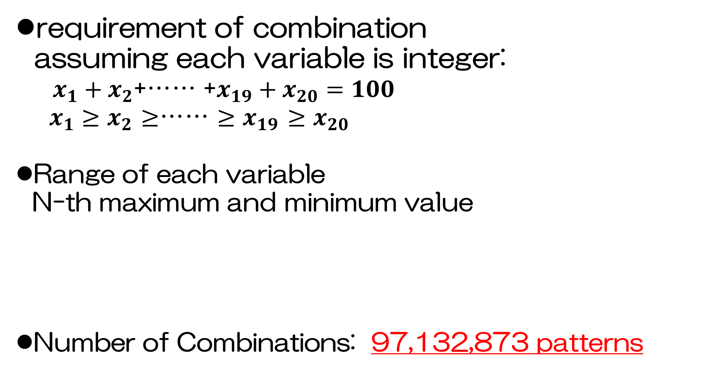
Combination when N=20 (trial)
requirement of combination
assuming each variable is integer:
$x_{1}+x_{2}$+…… +$x_{19}+x_{20}=100$
$x_{1}≥x_{2}$ $≥$…… $≥x_{19}$ $≥x_{20}$
Range of each variable
N-th maximum and minimum value
Number of Combinations: 97,132,873 patterns
Is AUF safe or unsafe?
 | ｘ_{１} | ｘ_{２} | ｘ_{３} | ｘ_{４} | ｘ_{５} | ｘ_{６} | ｘ_{７} | ｘ_{８} | ｘ_{９} | ｘ_{１０} | ｘ_{１１} | ｘ_{１２} | ｘ_{１３} | ｘ_{１４} | ｘ_{１５} | ｘ_{１６} | ｘ_{１７} | ｘ_{１８} | ｘ_{１９} | ｘ_{２０}
Max. | 100 | 50 | 33 | 25 | 20 | 16 | 14 | 12 | 11 | 10 | 9 | 8 | 7 | 7 | 6 | 6 | 5 | 5 | 5 | 5
Mini. | ５ | 0 | 0 | 0 | 0 | 0 | 0 | 0 | 0 | 0 | 0 | 0 | 0 | 0 | 0 | 0 | 0 | 0 | 0 | 0
Notes:
a

Slide 21
Number of combination by frequency
frequency | # of combi. | X₁ (largest variable in combination)
 |  | Max. | Mini. | mode | # of combination of mode | ratio（％）
20 | 97,132,873 | 100 | 5 | 20 | 5,498,387 | 5.7
19 | 86,658,411 | 100 | 6 | 20 | 4,865,168 | 5.6
18 | 75,772,412 | 100 | 6 | 21 | 4,214,238 | 5.6
17 | 64,684,584 | 100 | 6 | 21 | 3,565,531 | 5.5
16 | 53,662,038 | 100 | 7 | 22 | 2,914,553 | 5.4
15 | 43,018,955 | 100 | 7 | 22 | 2,307,803 | 5.4
14 | 33,097,743 | 100 | 8 | 23 | 1,743,387 | 5.3
13 | 24,234,058 | 100 | 8 | 23 | 1,248,206 | 5.2
12 | 16,713,148 | 100 | 9 | 24 | 840,657 | 5.0
11 | 10,718,685 | 100 | 10 | 25 | 523,214 | 4.9
10 | 6,292,069 | 100 | 10 | 27 | 296,777 | 4.7
9 | 3,314,203 | 100 | 12 | 28 | 149,938 | 4.5
8 | 1,527,675 | 100 | 12 | 30 | 65,728 | 4.3
7 | 596,763 | 100 | 15 | 32 | 24,135 | 4.0
6 | 189,509 | 100 | 17 | 36 | 7,119 | 3.8
5 | 46,262 | 100 | 20 | 40 | 1,592 | 3.4
4 | 8,037 | 100 | 25 | 46 | 251 | 3.1
3 | 884 | 100 | 34 | 50 | 26 | 2.9
2 | 51 | 100 | 50 | ― | 1 | 2.0

Slide 22
unsafe combinations by p% rule ( freq. N=20)
X₁ | freq. | X₁ | freq. | X₁ | freq. | X₁ | freq. | X₁ | freq.
100 | 1 | 89 | 19 | 78 | 195 | 67 | 373 | 56 | 195
99 | 1 | 88 | 30 | 77 | 195 | 66 | 373 | 55 | 139
98 | 2 | 87 | 30 | 76 | 272 | 65 | 272 | 54 | 139
97 | 2 | 86 | 45 | 75 | 272 | 64 | 272 | 53 | 139
96 | 4 | 85 | 45 | 74 | 373 | 63 | 272 | 52 | 139
95 | 4 | 84 | 67 | 73 | 373 | 62 | 272 | 51 | 139
94 | 7 | 83 | 67 | 72 | 508 | 61 | 272 | 50 | 97
93 | 7 | 82 | 97 | 71 | 508 | 60 | 195 | 49 | 95
92 | 12 | 81 | 97 | 70 | 373 | 59 | 195 | 48 | 90
91 | 12 | 80 | 139 | 69 | 373 | 58 | 195 | 46 | 52
90 | 19 | 79 | 139 | 68 | 373 | 57 | 195 | 47 | 78
Total |  |  |  |  | 8,849
only 8,849 sets in 97,132,873 sets (0.01%)

Slide 23
Maximum number of combinations grouping freq. N=20 combinations by each statistic
StDev | Skew | Kurt | Median | Intruder | N=30 | N=20 | difference
＊ |  |  |  |  | 331,258 | 223,627 | 107,631
＊ | ＊ |  |  |  | 873 | 550 | 323
＊ | ＊ | ＊ |  |  | 23 | 16 | 7
＊ | ＊ | ＊ | ＊ |  | 23 | 12 | 11
＊ | ＊ | ＊ | ＊ | ＊ | 22 | 9 | 13

Slide 24
Range of each statistic grouping by SD, Skewness and Kurtosis (freq. N=20)
Count | freq. | Max. SD | Mini. SD | Max. Skew. | Mini. Skew. | Max. Kurt | Mini. Kurt
16 | 2 | 4.180153611 | 3.741657387 | 0.57644737 | 0.361706944 | -0.587458267 | -0.840557276
15 | 13 | 4.565315462 | 3.524351377 | 0.964551851 | 0.192366206 | 0.309376382 | -1.054150134
14 | 64 | 4.565315462 | 3.324549831 | 0.955694047 | 0.145282975 | 0.530688627 | -1.231641448
13 | 155 | 4.963021151 | 3.077935056 | 0.901252349 | 0.124964037 | 0.334557548 | -1.371295887
12 | 445 | 5.211323703 | 2.901905 | 1.105031963 | 0.083177673 | 0.882366328 | -1.325211176
11 | 1,153 | 5.380275868 | 2.91998558 | 1.35646267 | 0.060994516 | 1.329705653 | -1.43192732
10 | 3,233 | 5.830951895 | 2.695024656 | 1.50255637 | -0.009153874 | 2.780946447 | -1.463372549
9 | 8,186 | 5.938279035 | 2.675424216 | 2.643593746 | -0.054613964 | 8.856069776 | -1.506246692
8 | 20,059 | 6.316228055 | 2.533979604 | 2.790656548 | -0.129051837 | 9.651964674 | -1.619289547
7 | 46,302 | 6.844129255 | 2.406132516 | 3.167347883 | -0.377822461 | 11.83376246 | -1.677127049
6 | 109,605 | 7.813618341 | 2.339590607 | 3.529878009 | -0.44212357 | 14.2766552 | -1.701512451
5 | 269,146 | 8.926601286 | 2.152110347 | 3.859596389 | -0.595837348 | 16.21353047 | -1.755565919
4 | 718,999 | 10.35679284 | 1.91942974 | 4.019587737 | -0.71911404 | 17.17271192 | -1.858246651
3 | 2,210,969 | 13.58404637 | 1.716790151 | 4.237554114 | -1.141558149 | 18.50919755 | -1.934757558
2 | 8,524,260 | 15.97366253 | 1.376494403 | 4.412088065 | -1.578947368 | 19.62372574 | -2.036823063

Slide 25
6.Comparison between Various Sets of Synthetic Microdata
Comparison of original microdata and each set of synthetic microdata
No. |  | 1 Original microdata |  | 2 Hierarchization, and kurtosis, skewness and λ of Box-Cox transformation |  |  | 3 Kurtosis and skewness |  |  | 4 Multivariate lognormal random numbers
 |  | Living expenditure | Food | Living expenditure | Food |  | Living expenditure | Food |  | Living expenditure | Food
１ |  | 125,503.5 | 29,496.1 | 110,487.8 | 25,143.0 |  | 107,684.0 | 23,459.9 |  | 133,549.9 | 38,559.9
２ |  | 255,675.9 | 25,806.2 | 232,691.8 | 37,905.5 |  | 281,880.8 | 56,520.4 |  | 123,716.6 | 42,930.1
３ |  | 175,320.4 | 38,278.2 | 213,320.2 | 30,531.9 |  | 254,267.3 | 37,419.4 |  | 152,784.8 | 67,263.8
４ |  | 181,085.6 | 74,122.1 | 183,430.4 | 75,469.1 |  | 294,589.9 | 112,843.9 |  | 195,764.8 | 8,286.1
５ |  | 124,471.0 | 33,256.8 | 134,867.6 | 39,568.9 |  | 193,191.6 | 54,363.3 |  | 202,865.8 | 75,558.0
６ |  | 145,717.7 | 46,992.8 | 132,976.4 | 39,333.7 |  | 189,242.7 | 53,980.3 |  | 193,003.4 | 70,994.2
７ |  | 319,114.3 | 113,177.1 | 242,622.5 | 68,472.2 |  | 151,183.6 | 55,303.2 |  | 191,620.1 | 52,311.7
８ |  | 253,685.2 | 67,253.6 | 320,055.9 | 113,008.5 |  | 271,338.1 | 79,991.4 |  | 72,773.7 | 13,621.6
９ |  | 236,447.6 | 61,129.8 | 246,568.6 | 60,079.7 |  | 157,306.9 | 50,650.9 |  | 201,114.6 | 74,899.0
１０ |  | 137,315.3 | 27,050.1 | 144,192.6 | 32,572.9 |  | 167,431.0 | 36,116.3 |  | 217,530.7 | 60,736.0
１１ |  | 253,393.7 | 47,205.6 | 267,708.8 | 60,344.8 |  | 270,301.8 | 78,246.4 |  | 297,608.7 | 77,464.3
１２ |  | 232,141.8 | 52,259.6 | 212,050.7 | 37,656.3 |  | 223,946.8 | 43,827.9 |  | 175,993.6 | 71,416.6
１３ |  | 214,540.4 | 54,920.9 | 213,439.1 | 50,862.2 |  | 225,103.2 | 63,861.2 |  | 297,653.0 | 86,400.5
１４ |  | 234,151.4 | 74,993.0 | 205,595.0 | 73,919.1 |  | 165,972.3 | 49,350.6 |  | 123,197.1 | 31,645.5
１５ |  | 278,431.0 | 78,916.1 | 282,652.7 | 79,126.9 |  | 249,749.1 | 73,474.1 |  | 277,501.6 | 69,910.5
１６ |  | 197,180.8 | 72,909.6 | 221,515.6 | 73,772.7 |  | 183,281.1 | 48,672.3 |  | 235,221.1 | 58,700.6
１７ |  | 118,895.1 | 48,821.6 | 127,964.3 | 50,240.7 |  | 115,639.3 | 71,059.5 |  | 182,363.2 | 49,433.2
１８ |  | 130,482.8 | 47,798.5 | 159,328.0 | 48,533.5 |  | 170,231.1 | 38,723.5 |  | 158,939.4 | 45,131.8
１９ |  | 147,969.1 | 50,277.9 | 133,795.5 | 47,660.6 |  | 125,789.2 | 22,188.5 |  | 212,194.2 | 37,995.6
２０ |  | 150,973.7 | 48,291.0 | 127,232.9 | 48,754.2 |  | 114,366.4 | 42,903.1 |  | 267,100.1 | 59,697.3

Slide 26
The most useful microdata from the indicators in the below table are in column number 2.
No. |  | 1 Original microdata |  | 2 Hierarchization, and kurtosis, skewness and λ of Box-Cox transformation |  |  | 3 Kurtosis and skewness |  |  | 4 Multivariate lognormal random numbers
 |  | Living expenditure | Food | Living expenditure | Food |  | Living expenditure | Food |  | Living expenditure | Food
Mean |  | 195,624.8 | 54,647.8 | 195,624.8 | 54,647.8 |  | 195,624.8 | 54,647.8 |  | 195,624.8 | 54,647.8
Standard deviation |  | 59,892.6 | 21,218.1 | 59,892.6 | 21,218.1 |  | 59,892.6 | 21,218.1 |  | 59,892.6 | 21,218.1
Kurtosis |  | -1.004164 | 1.628974 | -0.810215 | 1.473853 |  | -1.220185 | 1.721354 |  | -0.212358 | -0.052164
Skewness |  | 0.346305 | 0.992579 | 0.310913 | 1.050568 |  | 0.160612 | 0.949106 |  | 0.035785 | -0.709361
Correlation coefficients |  | 0.642511 |  | 0.689447 |  |  | 0.642511 |  |  | 0.642511
Maximum value |  | 319,114.3 | 113,177.1 | 320,055.9 | 113,008.5 |  | 294,589.9 | 112,843.9 |  | 297,653.0 | 86,400.5
Minimum value |  | 118,895.1 | 25,806.2 | 110,487.8 | 25,143.0 |  | 107,684.0 | 22,188.5 |  | 72,773.7 | 8,286.1
Note that for reference, column number 4 is the same as the trial synthetic microdata method.

Slide 27
Scatter plots of living expenditure and food for each microdata
Food
Hierarchization, and kurtosis, skewness and λ of Box-Cox transformation
Kurtosis and skewness
Multivariate lognormal random numbers
living expenditure

Slide 28
Example Result Table for Academic Use File
Items |  |  |  |  |  |  | Living expenditure |  |  | Food
No. | A | B | C | D | E | F | Frequency | Mean | SD | Frequency | Mean | SD
1 | 2 | 1 | 1 | 2 | 5 | 1 | 3 | 185,499.9 | 65,680.5 | 3 | 31,193.5 | 6,406.9
2 | 2 | 1 | 1 | 3 |  |  | 6 | 210,086.9 | 73,208 | 6 | 65,988.7 | 27,387.3
 | 2 | 1 | 1 | 3 | 6 | 1 | 3 | 150,424.8 | 28,599.3 | 3 | 51,457.2 | 20,795.2
 | 2 | 1 | 1 | 3 | 7 | 1 | 3 | 269,749.0 | 43,611.7 | 3 | 80,520.1 | 28,447.0
3 | 3 | 1 | 1 | 1 |  |  | 7 | 221,022.1 | 45,197.7 | 7 | 58,322.1 | 18,550.2
 | 3 | 1 | 1 | 1 | 5 | 1 | 4 | 209,347.8 | 50,580.8 | 4 | 45,359.0 | 12,618.4
 | 3 | 1 | 1 | 1 | 6 | 1 | 3 | 236,587.8 | 40,679.9 | 3 | 75,606.2 | 3,049.8
4 | 3 | 1 | 1 | 2 | 5 | 1 | 4 | 137,080.2 | 15,119.7 | 4 | 48,797.2 | 1,071.9
Mean |  |  |  |  |  |  | 195,624.8 |  |  | 54647.8
Standard deviation |  |  |  |  |  |  | 59,892.6 |  |  | 21218.1
Kurtosis |  |  |  |  |  |  | -1.004 |  |  | 1.629
Skewness |  |  |  |  |  |  | 0.346 |  |  | 0.993
Correlation coefficients |  |  |  |  |  |  | 0.643
λ |  |  |  |  |  |  | 0
A: 5-year age groups; B: employment/unemployed; C: company classification;
D: company size; E: industry code; F: occupation code

Slide 29
7. Conclusions and Future Outlook
Conclusions
We suggested improvements to synthetic microdata created by the National Statistics Center for statistics education and training.
We created new synthetic microdata using several methods that adhere to this disclosure limitation method.
The results show that kurtosis, skewness, and Box-Cox transformation λ are useful for creating synthetic microdata in addition to frequency, mean, standard deviation, and correlation coefficient which have previously been used as indicators.
Next Steps
Decide the number of cross fields (dimensionality) of the basic table and details table and the style (indicators to tabulate) of the result table according to the statistical fields in the public survey.
Expand this work to the creation and improvement of synthetic microdata from other surveys.

Slide 30
References
Anscombe, F.J.(1973), "Graphs in Statistical Analysis," American Statistician, 17-21. Bethlehem, J. G., Keller, W. J. and Pannekoek, J.(1990) “Disclosure Control of Microdata”, Journal of the American Statistical Association, Vol. 85, No. 409 pp.38-45.
Defays, D. and Anwar, M.N.(1998) “Masking Microdata Using Micro-Aggregation”, Journal of Official Statistics, Vol.14, No.4, pp.449-461.
Domingo-Ferrer, J. and Mateo-Sanz, J. M.(2002) ”Practical Data-oriented Microaggregation for Statistical Disclosure Control”, IEEE Transactions on Knowledge and Data Engineering, vol.14, no.1, pp.189-201.
Höhne(2003) “SAFE- A Method for Statistical Disclosure Limitation of Microdata”, Paper presented at Joint ECE/Eurostat Work Session on Statistical Data Confidentiality, Luxembourg, pp.1-3.
Ito, S., Isobe, S., Akiyama, H.(2008) “A Study on Effectiveness of Microaggregation as Disclosure Avoidance Methods: Based on National Survey of Family Income and Expenditure”, NSTAC Working Paper, No.10, pp.33-66 (in Japanese).
Ito, S.(2009) “On Microaggregation as Disclosure Avoidance Methods”, Journal of Economics, Kumamoto Gakuen University, Vol.15, No.3・4, pp.197-232 (in Japanese)
Makita, N., Ito, S., Horikawa, A., Goto, T., Yamaguchi, K. (2013) “Development of Synthetic Microdata for Educational Use in Japan”, Paper Presented at 2013 Joint IASE / IAOS Satellite Conference, Macau Tower, Macau, China, pp.1-9.

Slide 31
Thank you for your attention.

Slide 32
Creating the Academic Use File
Synthetic Microdata based on frequency, SD, skewness and kurtosis
Original Data
tables
tabular items:
frequency, SD,
skewness, kurtosis
tabulation
individual
data
Making Academic Use File
freq., SD,
skewness,
kurtosis
Combination
by freq.
DB
extract
candi-date
data
GRG
non-linear
decide
combi. of data
collate
extract
narrow
store all of
combination
by frequency
because each
value is integer,
extract by
each statistic
approximation
using
MS-EXCEL
Solver
SD and skew. is the same,
kurtosis is approximate
transform
total to 100

Slide 33
Rules for output checking
Type of Statistics | Type of Output | Classification
Descriptive statistics | Frequency tables | Unsafe
 | Magnitude tables | Unsafe
 | Maxima, minima and percentiles(incl. median) | Unsafe
 | Mode | Safe
 | Means, indices, ratios, indicators | Unsafe
 | Concentration ratios | Safe
 | Higher moments of distributions（incl. variance, covariance, kurtosis, skewness） | Safe
 | Graphs: pictorial representations of actual data | Unsafe
Correlation and Regression Analysis | Linear regression coefficients | Safe
 | Non-linear regression coefficients | Safe
 | Estimation residuals | Unsafe
 | Summary and test statistics from estimates （R², X² etc.） | Safe
 | Correlation coefficients | Safe
Brandt, M., Franconi, L., Guerke, C., Hundepool, A., Lucarelli, M., Mol, J., Ritchie, F., Seri, G. and Welpton, R. (2010) Guidelines for the checking of output based on microdata research. Project Report. ESSnet SDC.

